Slide 1
Object Oriented Programming C++ Operator Overloading
Abeeda Akram

Slide 2
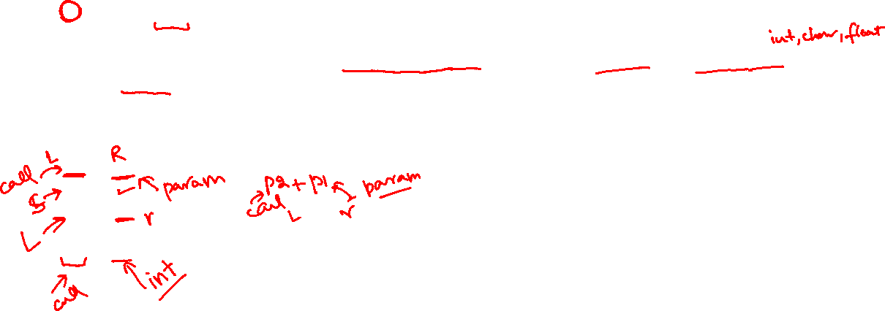
Member Functions
Can be defined inside class as member or just add prototype and define outside as normal member functions.
Operators that must be overloaded through member functions are:
=, [], (), ->, &(address of operator)
Binary operators:
Member function, needs one argument right operand can be class object or other datatype.
Left operand must be class object
All operators can be overloaded through member functions in which left operand is class object for example:
Point p1, p2(2, 3);
p1 + p2; //both are class objects of Point class
p1++;
p1 = p2;
//left operand is class object member function will work
p1 + 3;

Slide 3
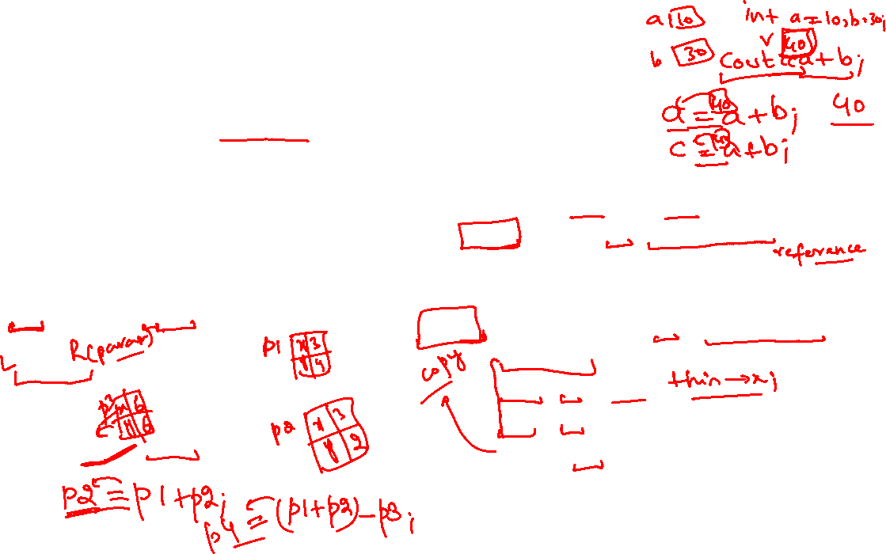
Binary Operator Addition (+)
Both operands are class objects.
Member function takes right operand of operation as one argument.
Called on left operand must be class object.
Can be called in two ways.
Point p1(3, 4), p2(3, 2);
p1.operator+(p2); // called on p1
Or
p1+p2;
// called on p1, p2 passed as argument
Point p3 = p1+p2;
// cascaded call
class Point {
int x, y;
public:
Point(int a=0, int b=0) { x=a; y=b;}
Point operator+ (const Point&);
};
//implementation
Point Point:: operator+(const Point& p){
Point R;
R.x = x + p.x;
R.y = y + p.y;
return R;
}

Slide 4
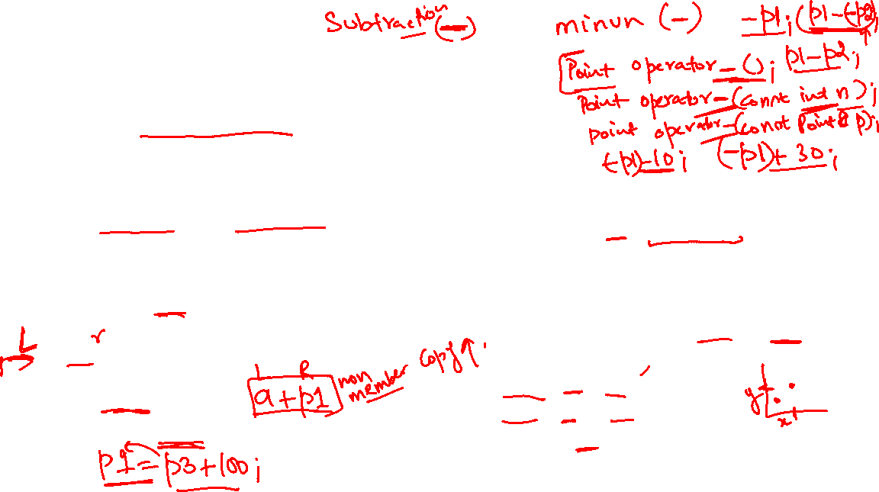
Binary Operator Addition (+)
One operand left one is class object.
Member function takes right operand of operation as one argument.
Called on left operand must be class object.
Can be called in two ways.
Point p1(3, 4);
p1.operator+(3); // called on p1
Or
p1+10; // called on p1, int 10 is passed as argument
int a = 10;
Point p3 = p1+a; // cascaded call
class Point {
int x, y;
public:
Point(int a=0, int b=0) { x=a; y=b;}
Point operator+ (const Point&);
Point operator+ (const int);
// with int
};
//implementation
Point Point:: operator+(const int n){
Point R;
R.x = x + n;
R.y = y + n;
return R;
}

Slide 5
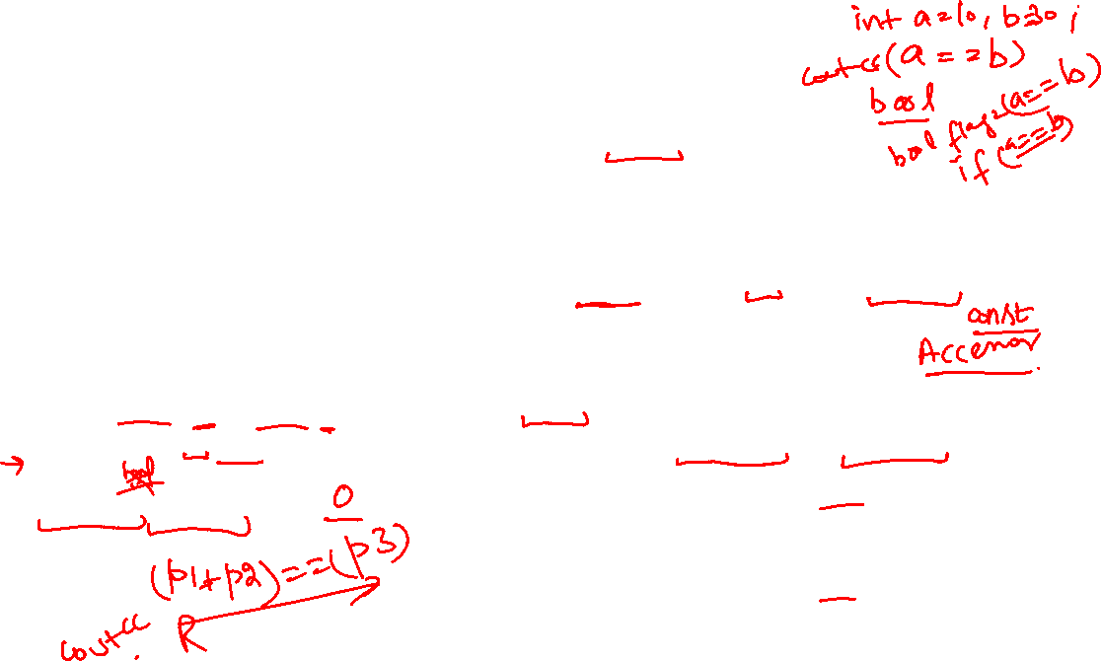
Binary Operator is equal to (==)
class Point {
int x, y;
public:
Point(int a=0, int b=0) { x=a; y=b;}
bool operator==(const Point&);
};
//implementation
bool Point:: operator==(const Point& p){
if (x == p.x && y == p.y)
return true;
else
return false;
}
Both operands should be class objects.
Member function takes right operand of operation as one argument.
Called on left operand must be class object.
Can be called in two ways.
Point p1(3, 4), p2(3, 2);
p1.operator==(p2); // called on p1
Or
cout << (p1==p2);

Slide 6
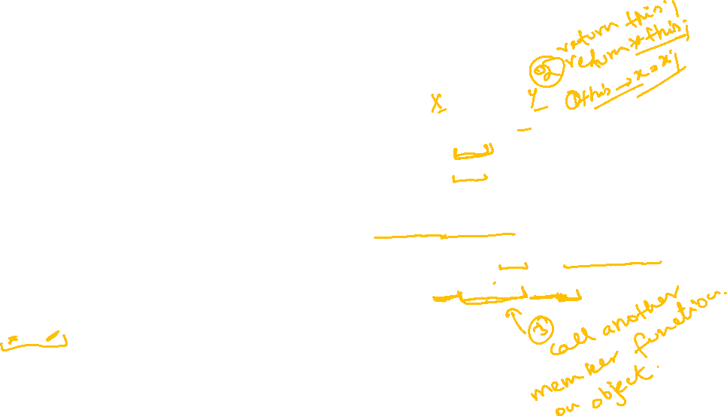
Binary Operator is not equal to (!=)
Both operands should be class objects.
Member function takes right operand of operation one argument.
Called on left operand must be class object.
Can be called in two ways.
Point p1(3, 4), p2(3, 2);
p1.operator!=(p2);
// called on p1
Or
cout << (p1!=p2);
class Point {
int x, y;
public:
Point(int a=0, int b=0) { x=a; y=b;}
bool operator==(const Point&);
bool operator!=(const Point&);
};
//Reuse == operator function
bool Point:: operator!=(const Point& p){
return !((*this) == p) ;
}

Slide 7
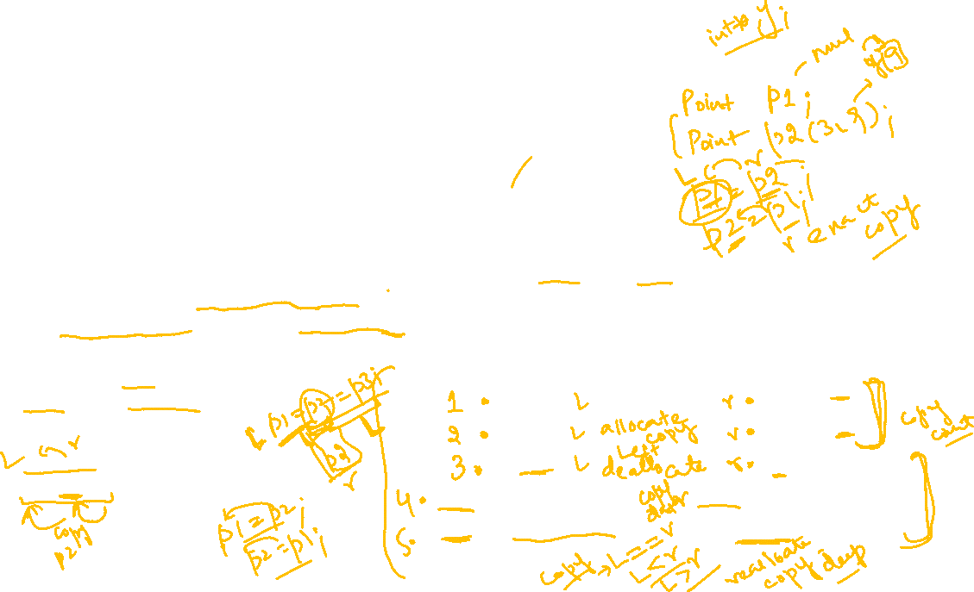
Binary Operator Assignment (=)
Member function is compulsory for assignment.
Both operands should be class objects
Member function takes right operand of operation as argument.
Called on left operand that must be class object.
Check state of both left and right object’s data members carefully.
If they are pointers address issues, due to different constructors, nullptr or valid memory address.
Dynamic arrays size mismatch issues.
Self assignment issue with pointer data members.
Can be called in two ways.
Point p1(3, 4), p2(3, 2), p3;
p1.operator=(p2);
// called on p1
Or
p1=p2; // called on p1
p1=p2=p3; // cascaded call
Left Operand | Right Operand
nullptr | nullptr
nullptr | Address
Address | nullptr
Address (Single Variable) | Address (Single Variable)
Address (Array Size Check) | Address (Array Size Check)

Slide 8
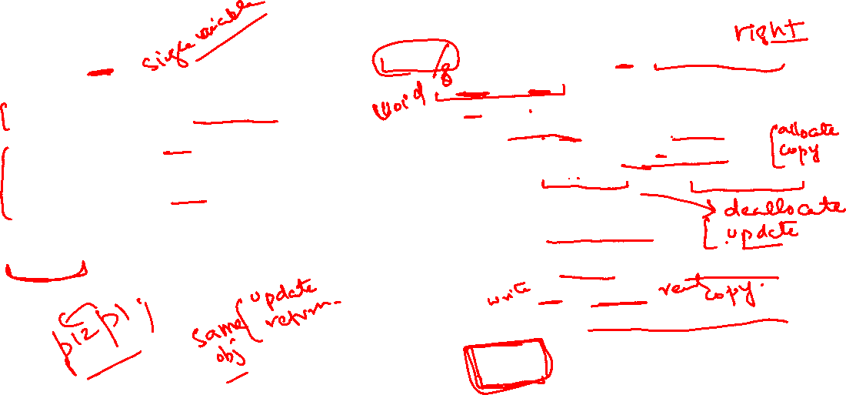
Binary Operator Assignment (=)
class Point {
int x, *y;
public:
Point() { x=0; y=nullptr; }
Point(int x, int y) {
this->x=x;
this->y=new int(y);
}
Point& operator=(const Point& p);
};
//implementation
Point& Point:: operator=(const Point& p){
if (this != &p) {
x = p.x;
if(y==nullptr && p.y!=nullptr)
y = new int(*(p.y));
else if(y!=nullptr && p.y==nullptr){
delete y;
y = nullptr;
}
else if(y!=nullptr && p.y!=nullptr)
*y = *(p.y);
// if arrays deep copy using loops
}
return *this;
}

Slide 9
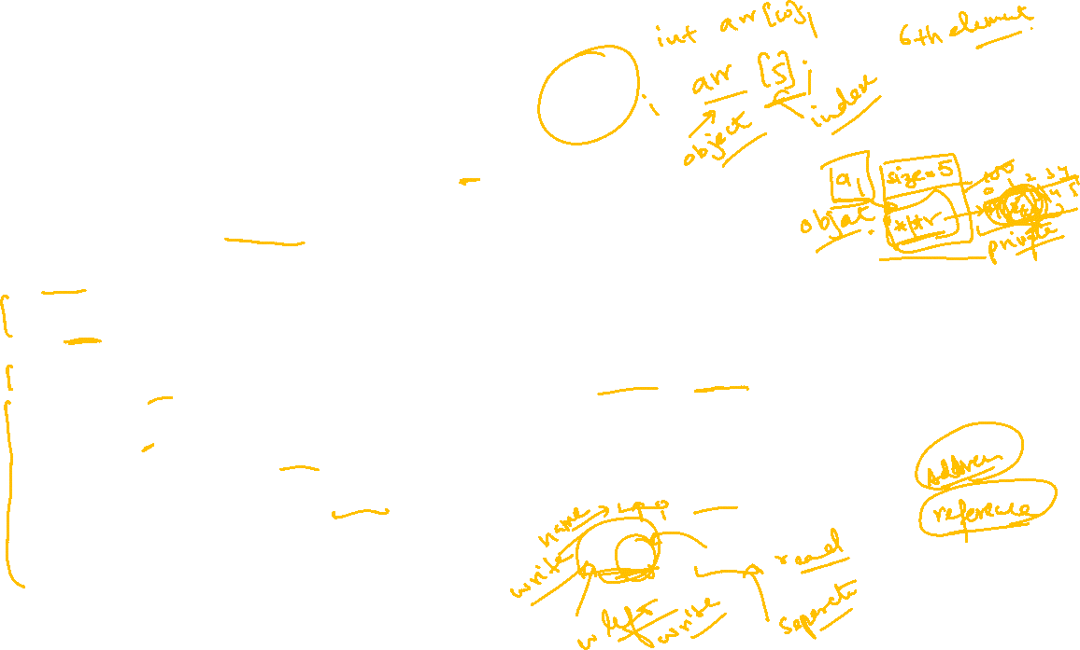
Binary Operator Subscript [ ]
Member function is compulsory for subscript operator.
Left operand should be class object and right should be int.
Member function takes right operand of operation as argument and called on left operand.
It provides access to elements of arrays defined inside objects as private data members.
For example: a class myArray is defined here.
class myArray{
int size; // Array size
int *ptr; // Pointer for dynamic 1-D Array
public:
myArray() { size=0; ptr=nullptr; }
myArray(int size) {
this->size=size;
if(size>0){
ptr = new int[size];
for (int i = 0; i < size; i++)
ptr[i] = i + 1;
}
else
ptr = nullptr;
}
};
If subscript operator is overloaded, then we can access the elements of private array in following way.
myArray a1(5);
// creates array inside object
// Subscript operator call for array inside object
a1[0] = 100;
// store 100 in element 1
a1[1] = a1[0];
// copy element 1 to element 2

Slide 10
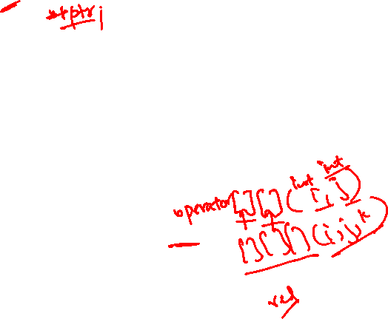
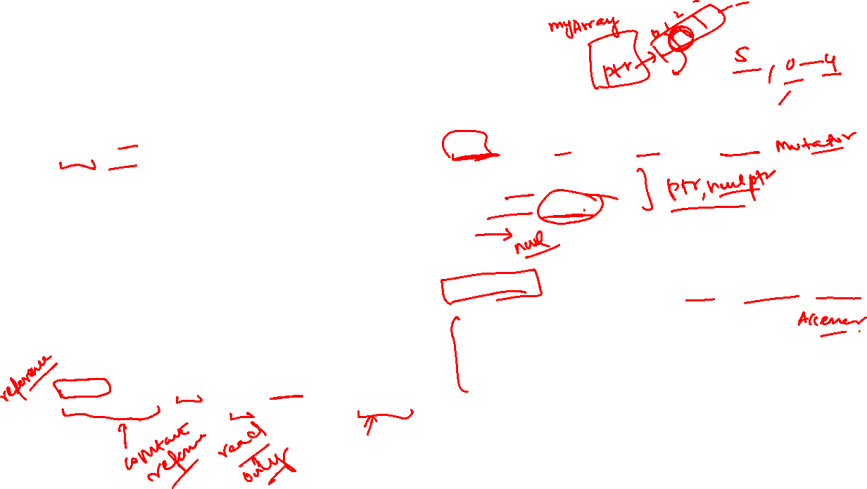
Binary Operator Subscript [ ]
class myArray{
int size; // Array size
int *ptr; // Pointer for dynamic 1-D Array
public:
myArray() { size=0; ptr=nullptr; }
myArray(int size) {
this->size=size;
if(size>0){
ptr = new int[size];
for (int i = 0; i < size; i++)
ptr[i] = i + 1;
}
else
ptr=nullptr;
}
int & operator[](const int i);
const int & operator[](const int i) const;
};
//implementation for Normal object
int & myArray::operator[](const int i){
// check if index i is in range
if ( i>=0 && i<size)
return ptr[i];
// return element by reference as lvalue
}
//implementation accessor for Constant object
const int & myArray::operator[](const int i) const{
// check if index i is in range
if ( i>=0 && i<size)
return ptr[i];
// return element by reference as constant rvalue
}

Slide 11






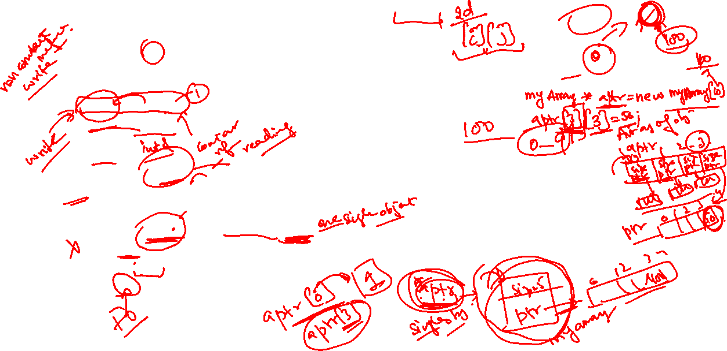


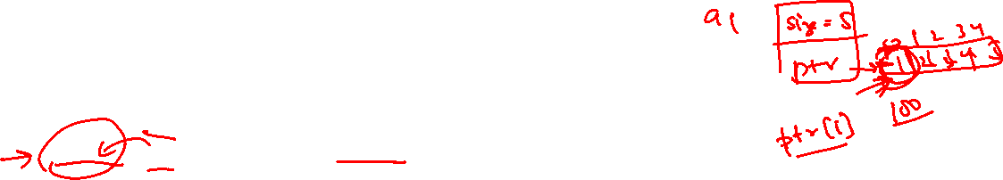
Binary Operator Subscript [ ]
Subscript operator call for array inside object
myArray a1(5); // creates array inside object
a1[0] = 100; // return reference to int element 1 of array
// store 100 in element 1
a1[1] = a1[0]; // copy element 1 to element 2
cout<< a1[1]; // print value of element 2
const myArray a2(3); // creates array of size 3 inside constant object
cout<< a2[1]; // return constant reference (read only) to int
a2[1] = 10; // wrong as constant reference is returned for constant object
Not work on pointers to objects directly
myArray *aptr = new myArray(5); // creates array inside object
aptr[3] = 100; // wrong as aptr is pointer
(*aptr)[3] = 100; //first dereference the pointer then access data
aptr[0][3] = 100;

